Slide 1
BigQuery Analysis
Shobhit Dalal

Slide 2
Understanding & Cleaning Data
By running the query below:
SELECT DATE(pickup_datetime) date, AVG(trip_distance) trip_distance,
FROM [nyc-tlc:yellow.trips]
GROUP BY 1
ORDER BY 1
We can see that there is huge variation on the avg_distance per day. Also, there are some negative values that does not make sense.
To clean this data (only look at trips with fare_amount/trip_distance ratio between 1 and 10)
SELECT SUM( fare_amount/trip_distance BETWEEN 1 AND 10)/ COUNT(*)
FROM [nyc-tlc:yellow.trips]
Ans 0.9557608689222268 i.e. 95.58% of the data
Again running the initial query we get the average distance around 3 miles with less variations. Now we can write a query to solve first question

Slide 3
What's the average speed of yellow cabs on odd days of the week (Monday, Wednesday, Friday, Sunday)?
Query:
SELECT DAYOFWEEK(DATE(TIMESTAMP(pickup_datetime))) dayofweek,
INTEGER(100*AVG(trip_distance/((dropoff_datetime-pickup_datetime)/3600000000)))/100 speed
FROM [nyc-tlc:yellow.trips]
WHERE fare_amount/trip_distance BETWEEN 1 AND 10
AND HOUR(pickup_datetime) BETWEEN 8 AND 23
AND (DAYOFWEEK(DATE(TIMESTAMP(pickup_datetime))) = 2
OR DAYOFWEEK(DATE(TIMESTAMP(pickup_datetime))) = 4
OR DAYOFWEEK(DATE(TIMESTAMP(pickup_datetime))) = 6
OR DAYOFWEEK(DATE(TIMESTAMP(pickup_datetime))) = 1)
GROUP BY 1
ORDER BY 1
Ans:
Row | dayofweek | speed
1 | 1 (Sunday) | 14.86 miles/hr
2 | 2 (Monday) | 13.31 miles/hr
4 | 4 (Wednesday) | 12.13 miles/hr
6 | 6 (Friday) | 12.03 miles/hr

Slide 4
Query Explanation
‘HOUR(pickup_datetime) BETWEEN 8 AND 23’ is used in where clause to include data only from 3:00 AM EST to 6:00 PM EST. The given pickup_datetime is in UTC, and we need to consider it as EST for our analysis, thus using HOUR function between 8 AND 23 offsets the data to EST for analysis.
‘(DAYOFWEEK(DATE(TIMESTAMP(pickup_datetime))) = 2
OR DAYOFWEEK(DATE(TIMESTAMP(pickup_datetime))) = 4
OR DAYOFWEEK(DATE(TIMESTAMP(pickup_datetime))) = 6
OR DAYOFWEEK(DATE(TIMESTAMP(pickup_datetime))) = 1)’
Above lines of code is used to filter for odd days i.e. Monday, Wednesday, Friday & Sunday.

Slide 5
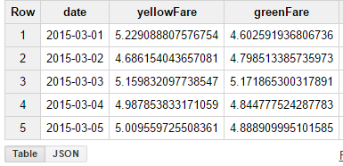
Green & yellow cabs fare comparisons for March 2015 (for each date)
Query:
SELECT yellow.ydate date, yellow.yellow_fare yellowFare, green.green_fare greenFare
FROM
(SELECT DATE(TIMESTAMP(pickup_datetime)) ydate, SUM((total_amount-tip_amount))/SUM(trip_distance) yellow_fare
FROM [nyc-tlc:yellow.trips]
WHERE fare_amount/trip_distance BETWEEN 1 AND 10
AND HOUR(pickup_datetime) BETWEEN 8 AND 23
AND MONTH(pickup_datetime) = 3
AND YEAR(pickup_datetime) = 2015
GROUP BY 1
ORDER BY 1) AS yellow
JOIN
(SELECT DATE(TIMESTAMP(pickup_datetime)) gdate, SUM((total_amount-tip_amount))/SUM(trip_distance) green_fare
FROM [nyc-tlc:green.trips_2015]
WHERE fare_amount/trip_distance BETWEEN 1 AND 10
AND HOUR(pickup_datetime) BETWEEN 8 AND 23
AND MONTH(pickup_datetime) = 3
GROUP BY 1
ORDER BY 1) AS green
ON yellow.ydate = green.gdate;
Ans:

Slide 6
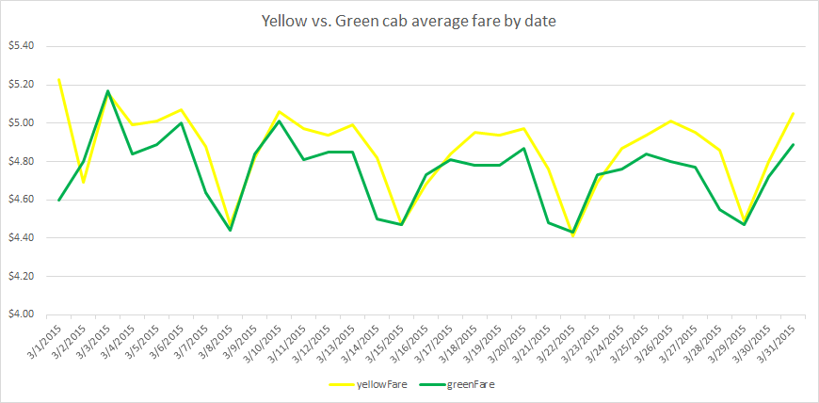
Green & yellow cabs fare comparisons for March 2015 (for each date)

Slide 7
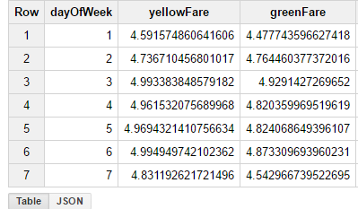
Green & yellow cabs fare comparisons for March 2015 (by day of week)
Query:
SELECT yellow.ydate dayOfWeek, yellow.yellow_fare yellowFare, green.green_fare greenFare
FROM
(SELECT DAYOFWEEK(TIMESTAMP(pickup_datetime)) ydate, SUM((total_amount-tip_amount))/SUM(trip_distance) yellow_fare
FROM [nyc-tlc:yellow.trips]
WHERE fare_amount/trip_distance BETWEEN 1 AND 10
AND HOUR(pickup_datetime) BETWEEN 8 AND 23
AND MONTH(pickup_datetime) = 3
AND YEAR(pickup_datetime) = 2015
GROUP BY 1
ORDER BY 1) AS yellow
JOIN
(SELECT DAYOFWEEK(TIMESTAMP(pickup_datetime)) gdate, SUM((total_amount-tip_amount))/SUM(trip_distance) green_fare
FROM [nyc-tlc:green.trips_2015]
WHERE fare_amount/trip_distance BETWEEN 1 AND 10
AND HOUR(pickup_datetime) BETWEEN 8 AND 23
AND MONTH(pickup_datetime) = 3
GROUP BY 1
ORDER BY 1) AS green
ON yellow.ydate = green.gdate;
Ans:

Slide 8
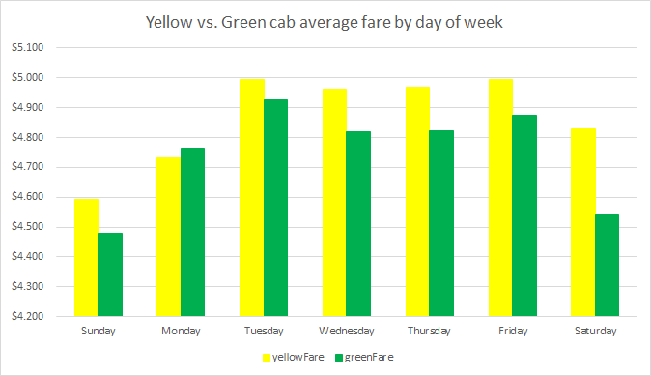
Green & yellow cabs fare comparisons for March 2015 (by day of week)

